Slide 1
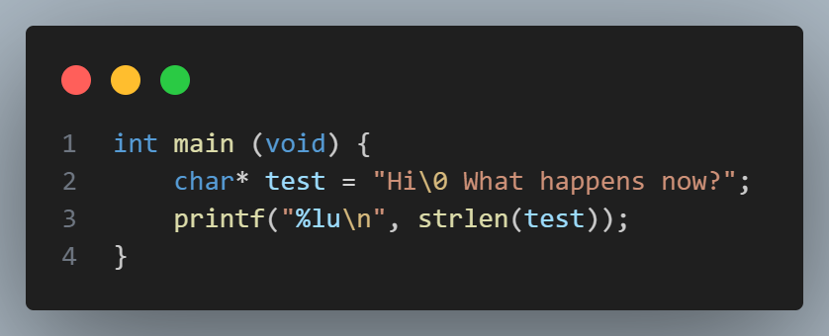
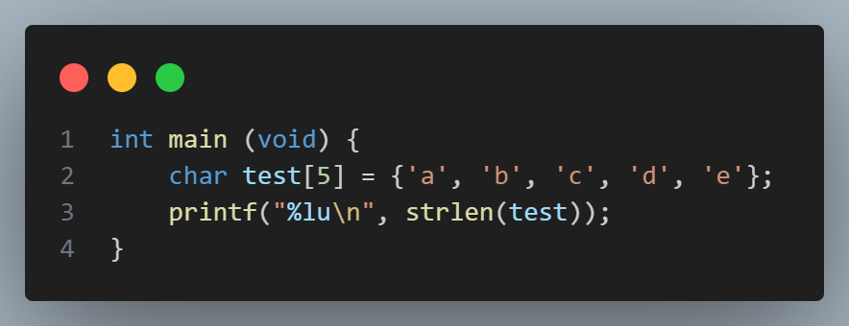
Questions before we start!
1) How might you have used arrays in PSET 1? Discuss with a partner.
2) What do you think this prints? Try it!
3) What do you think this prints? Try it!
Puzzles

Slide 2
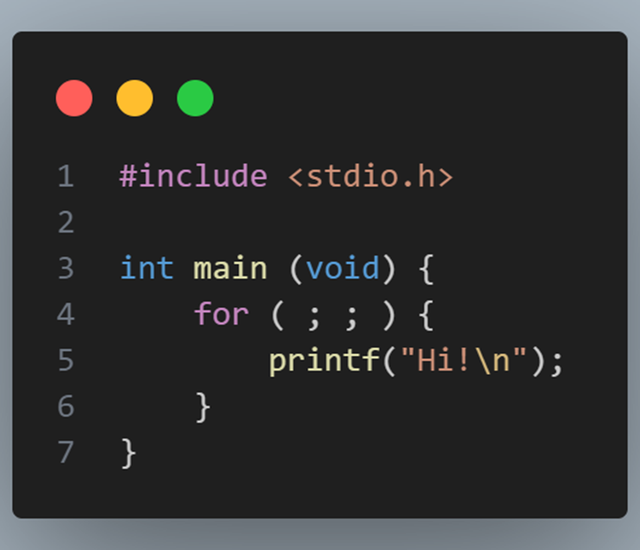
Puzzles from last time
Puzzles
1) What does this do?
2) Why?
C / for loop — DevDocs

Slide 3
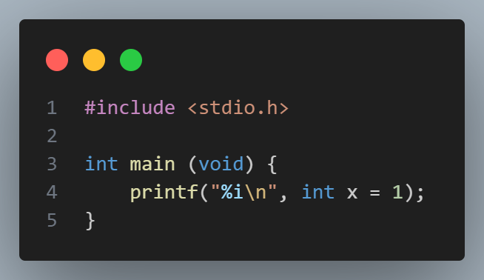
Puzzles from last time
Puzzles
1) What does this do?
2) Why?

Slide 4
cs50 section 2
Arrays!
Andrew Holmes, Fall 2023

Slide 5
Today’s plan
01
Design
03
Command Line
02
Arrays & strings!
04
PSET
Quick clean up from last week.
Argv, argc and compilers
The fun stuff!
Looking ahead!

Slide 6
01
Design

Slide 7
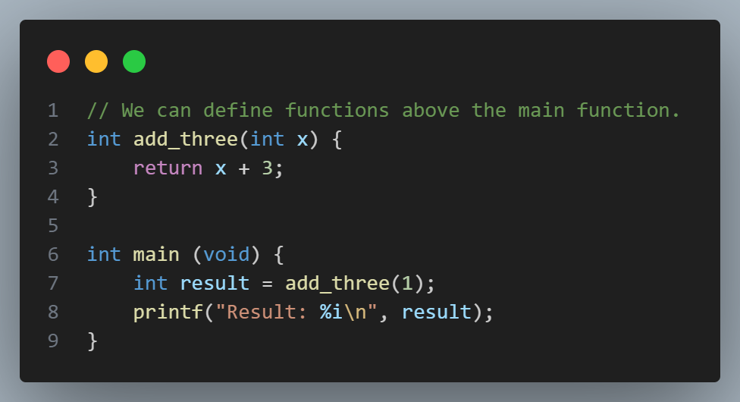
Functions
Design

Slide 8
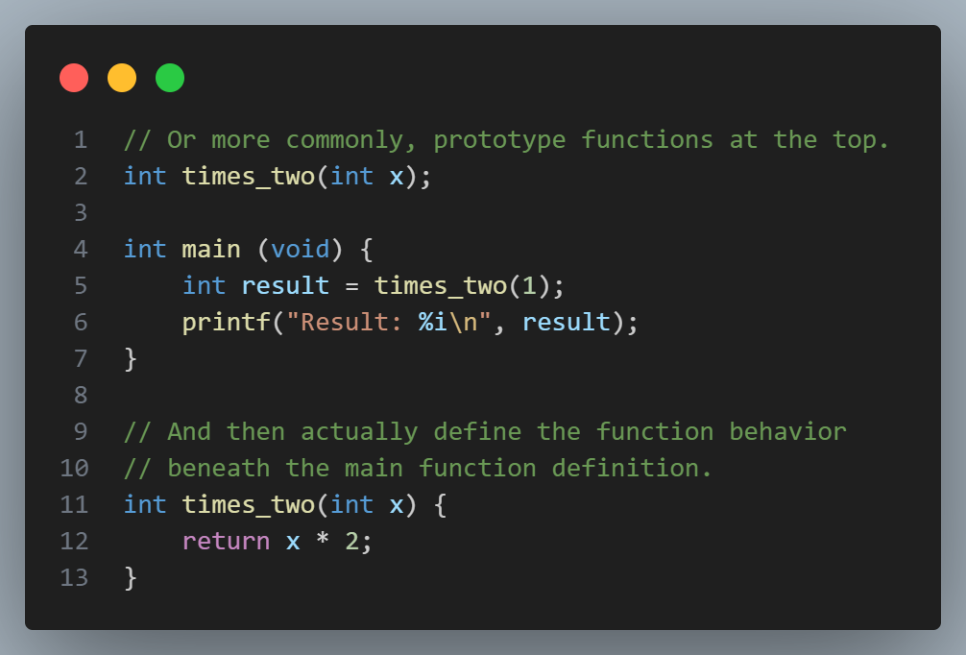
Functions
Design

Slide 9
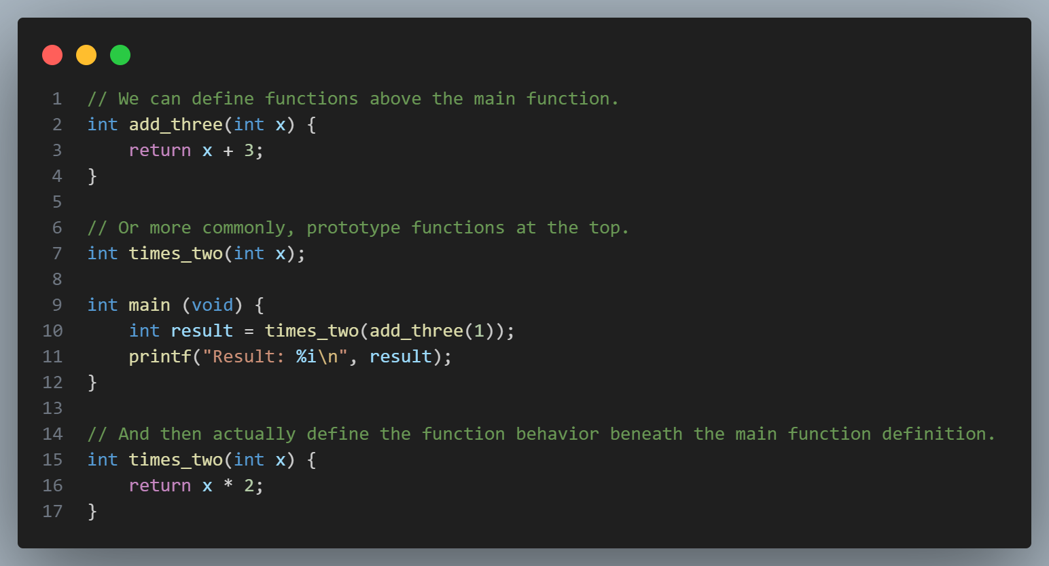
Functions
Functions

Slide 10
Functions – design thoughts
Design
Function prototypes generally preferred:
Double-enforcing/checking function typing.
Readability: main function most important, high-level overview of program.
Often don’t need to read function implementation, name and type should be informative.

Slide 11
Grading
Design
I’m most likely not grading your work, someone in my cohort will be!
3 is for good work with some minor mistakes. 4 is great. 5 is exceptional.
You can contact me if you are concerned about any grading issues.

Slide 12
Design tips
Design
Amulya’s design guide from 2022

Slide 13
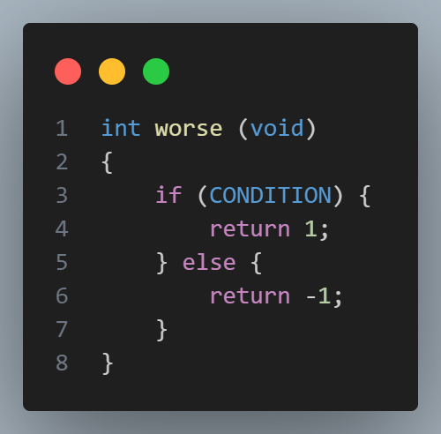
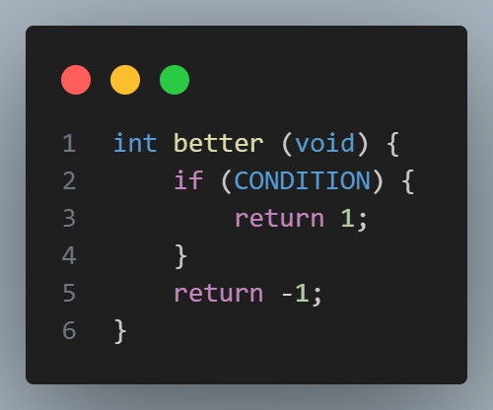
Design idea: reducing overkill ‘else’/extra indentation
Design

Slide 14
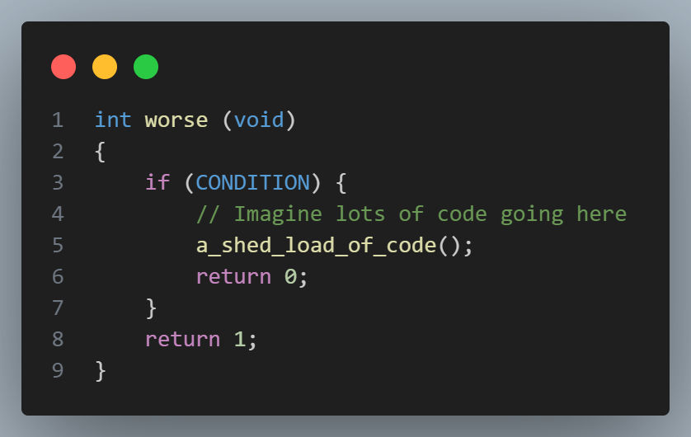
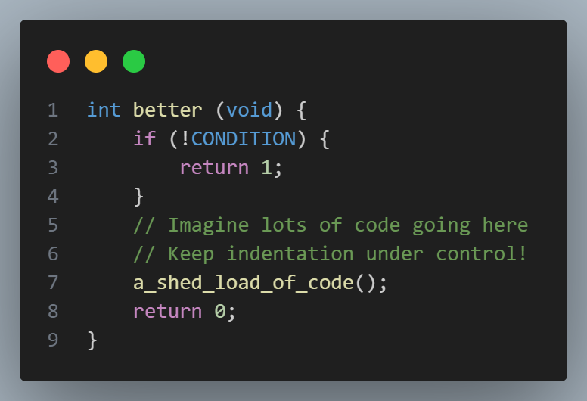
Design idea: choosing good conditions for readability
Design

Slide 15
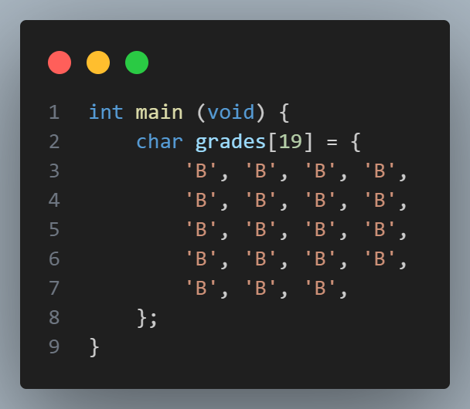
Design idea: magic numbers
Functions++

Slide 16
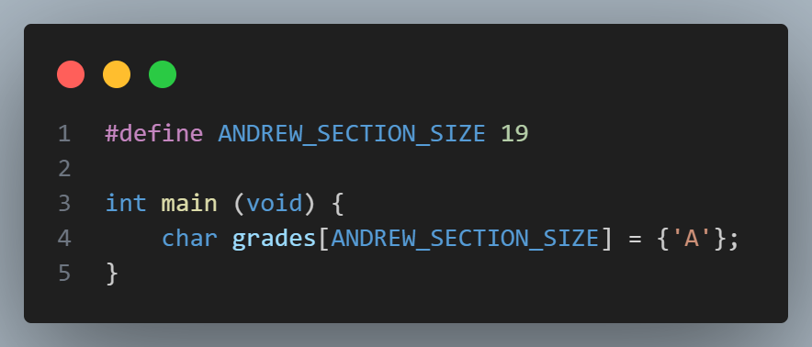
Design idea: magic numbers
Functions++
Remove ‘magic’ numbers
Array ‘syntactic sugar’.

Slide 17
02
Arrays

Slide 18
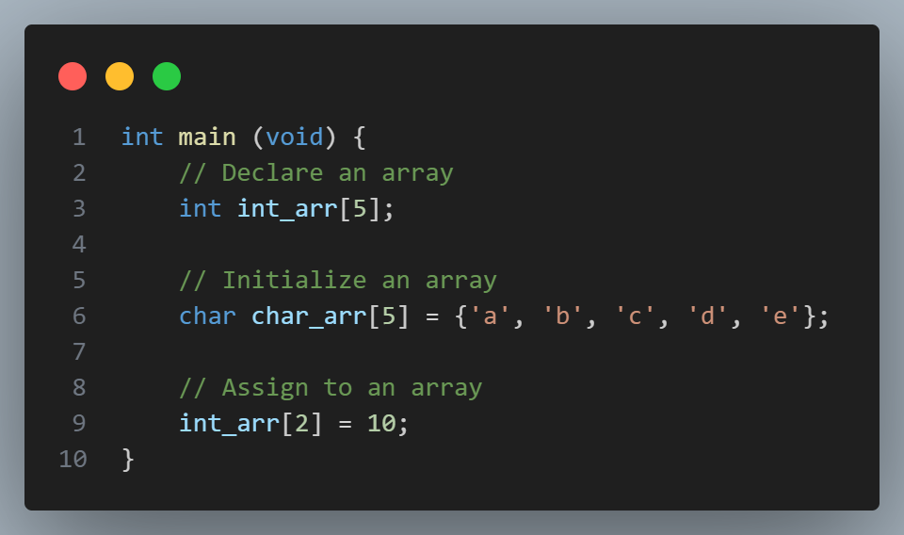
Arrays
Arrays

Slide 19
Arrays - declaration
Arrays
? | ? | ? | ? | ?
int_arr[0]
int_arr[3]

Slide 20
Arrays - declaration
Arrays
‘a’ | ‘b’ | ‘c’ | ‘d’ | ‘e’

Slide 21
Strings
Arrays

Slide 22
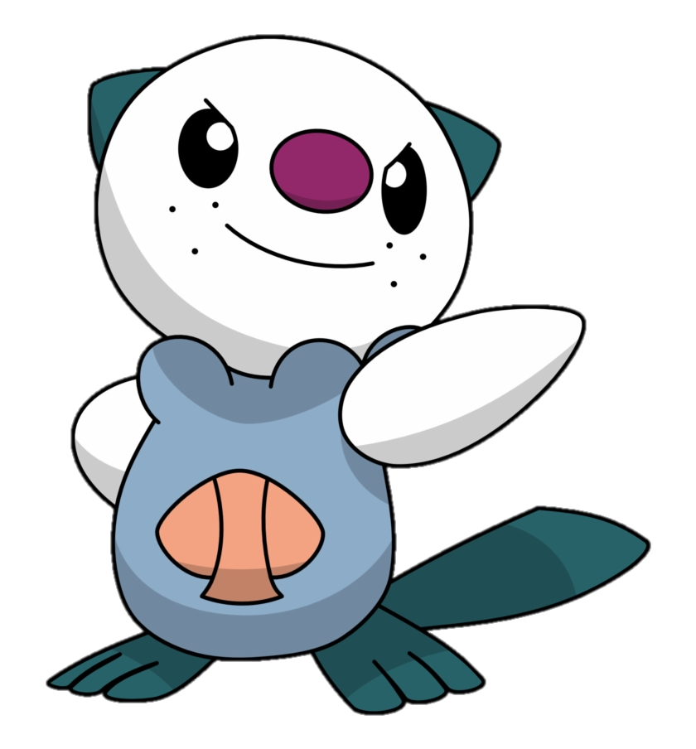
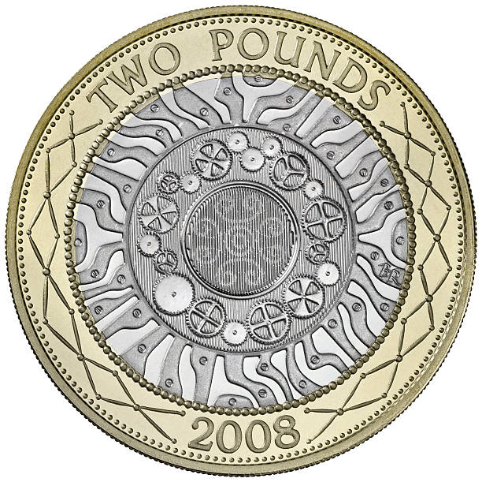
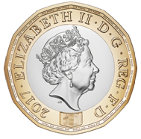
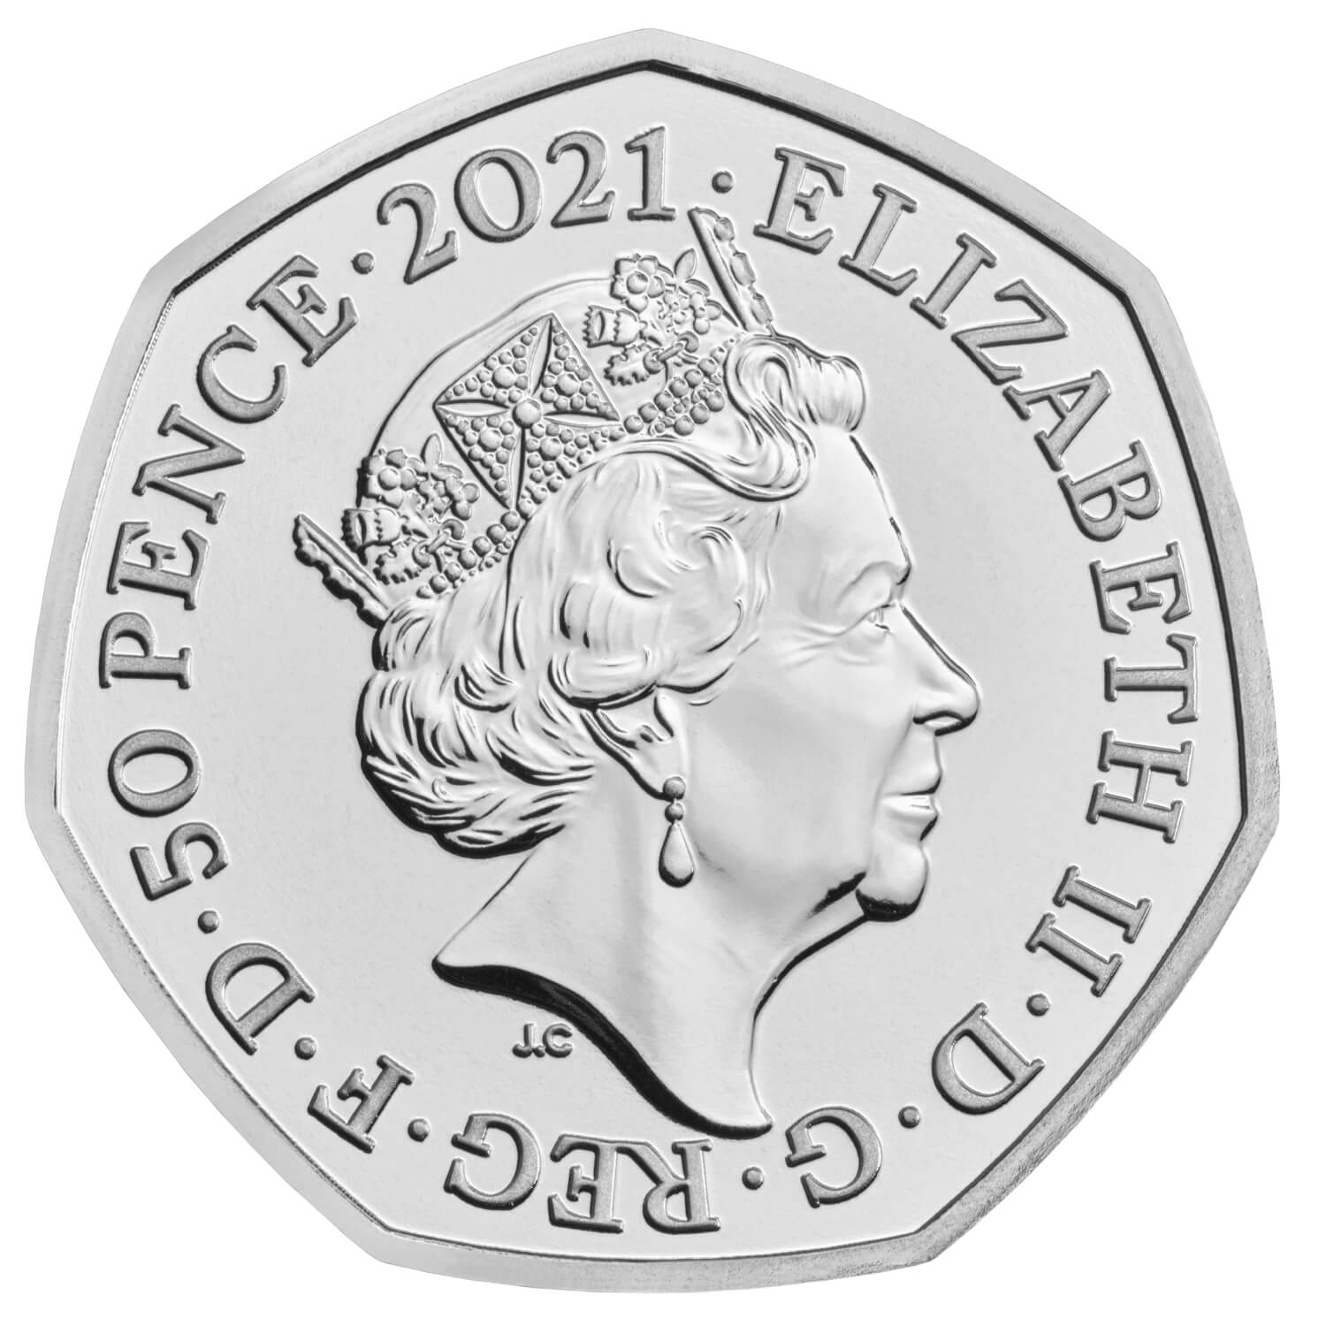
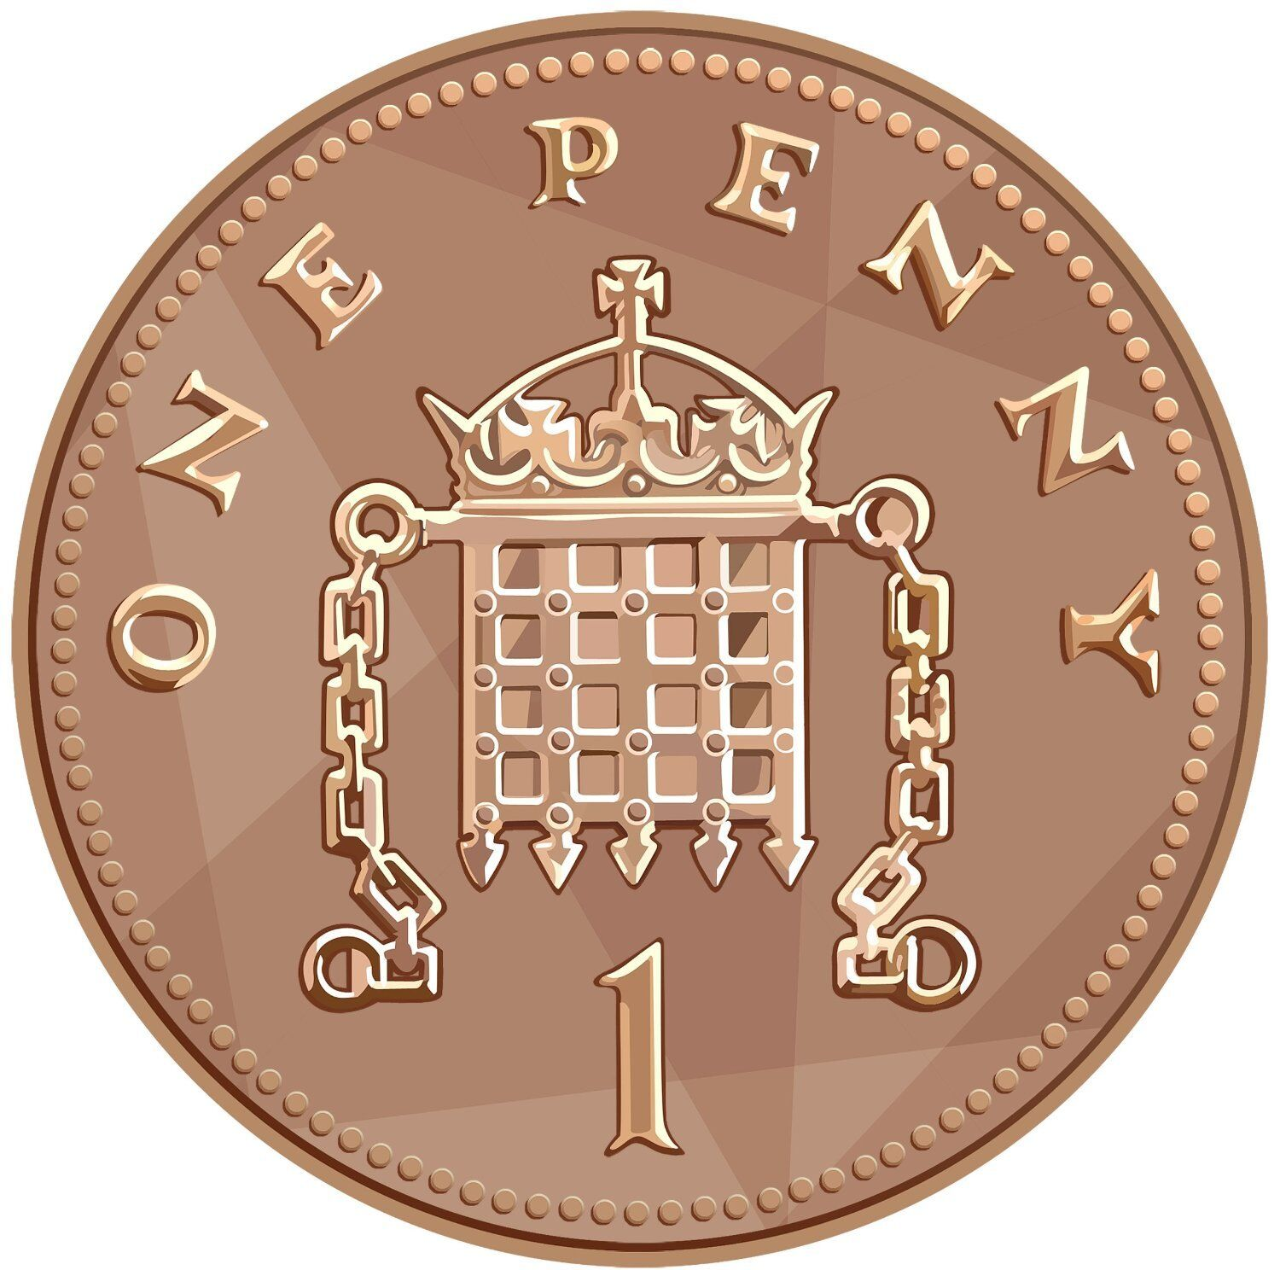
Writing code!
In pairs, investigate & implement:
The relation between an array variable (arr) and the first position of arr, arr[0].
Reimplement cash with British coins and using an array! (1p, 2p, 5p, 10p, 20p, 50p, £1, £2)
Practice!

